Slide 1
Un-Supervised ML : CLUSTERING
~ Pankaj

Slide 2
Explanation …
Clustering is similar to classification, but the basis is different.
In Clustering you don’t know what you are looking for, and you are trying to identify some segments or clusters in your data.
When you use clustering algorithms on your dataset, unexpected things can suddenly pop up like structures, clusters and groupings you would have never thought of otherwise.
In this part, you will understand and learn how to implement the following Machine Learning Clustering models:
K-Means Clustering
Hierarchical Clustering

Slide 3
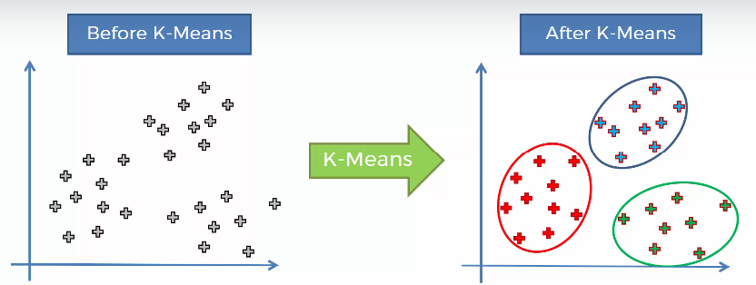
K-Means Clustering

Slide 4
K-Means Clustering

Slide 5
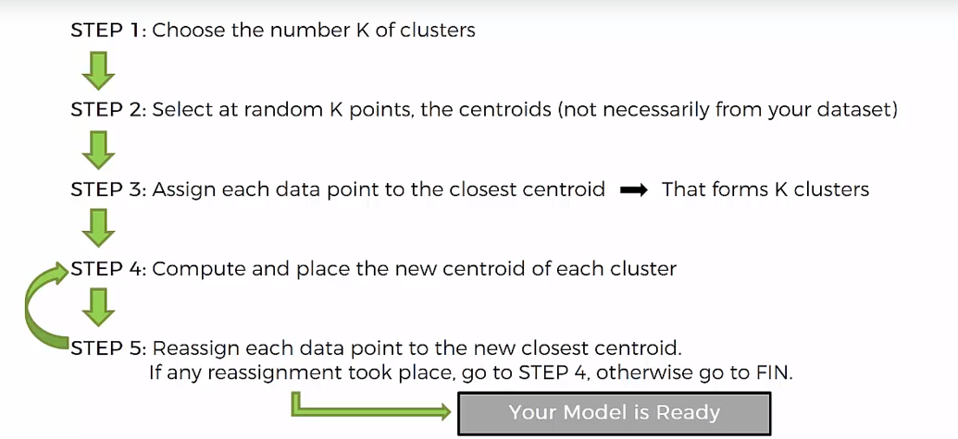
K-Means Clustering

Slide 6
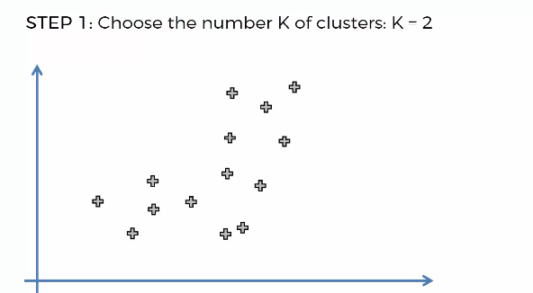
K-Means Clustering

Slide 7
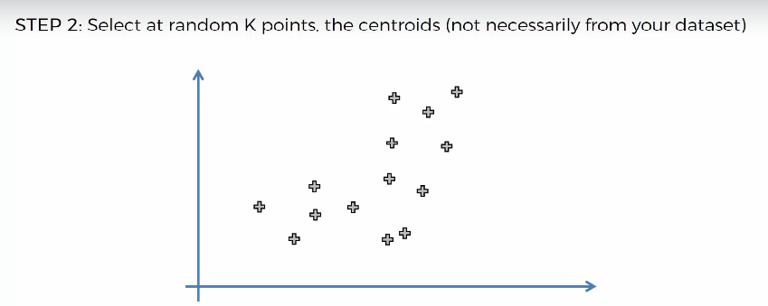
K-Means Clustering

Slide 8
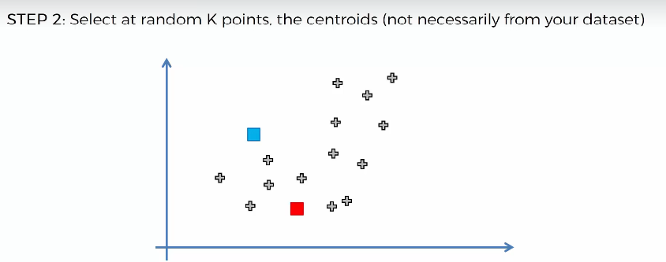
K-Means Clustering

Slide 9
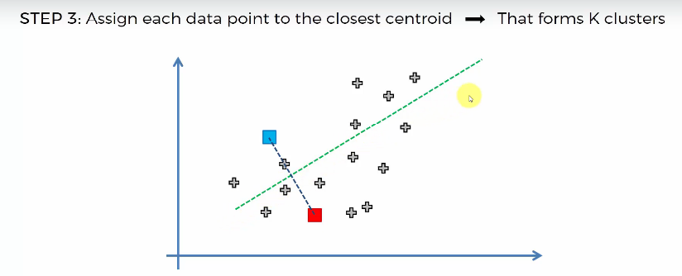
K-Means Clustering

Slide 10
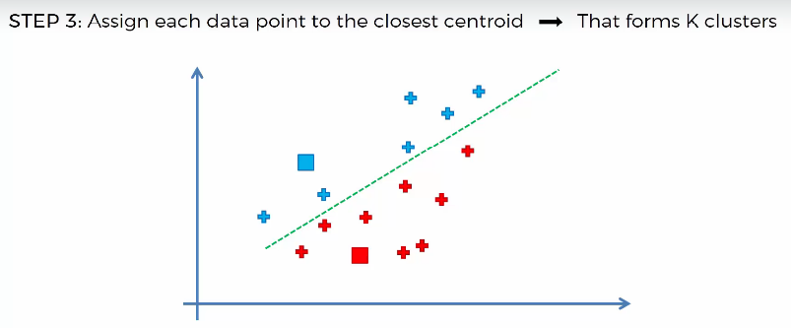
K-Means Clustering

Slide 11
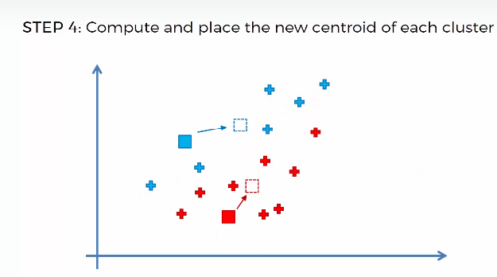
K-Means Clustering

Slide 12
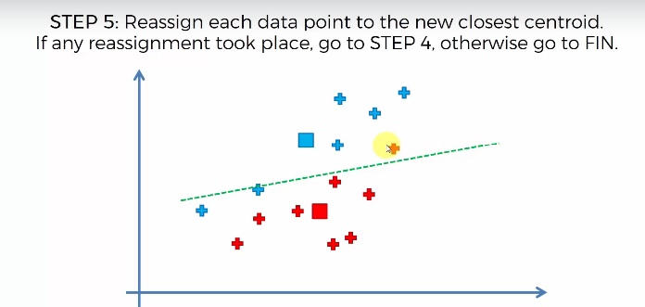
K-Means Clustering

Slide 13
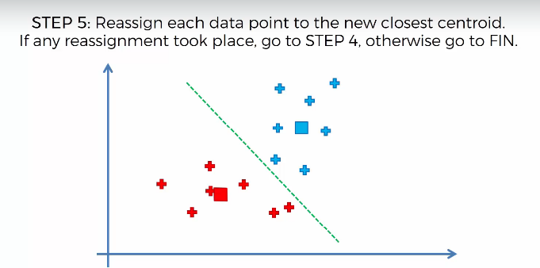

Slide 14
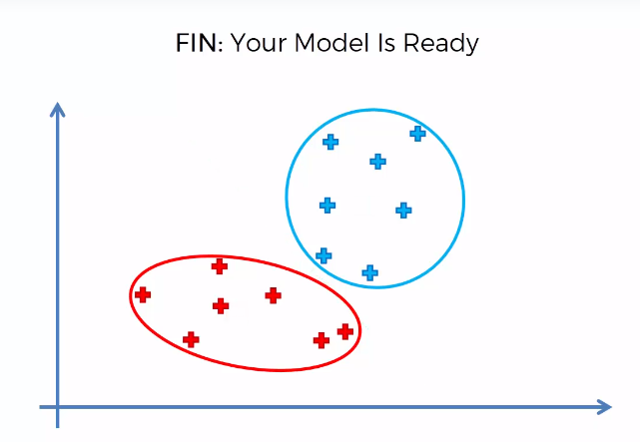
K-Means Clustering

Slide 15
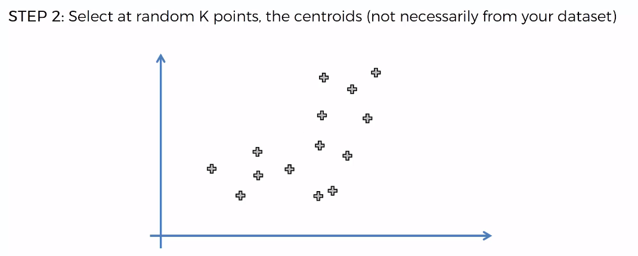
K-Means Clustering
At Start we had

Slide 16
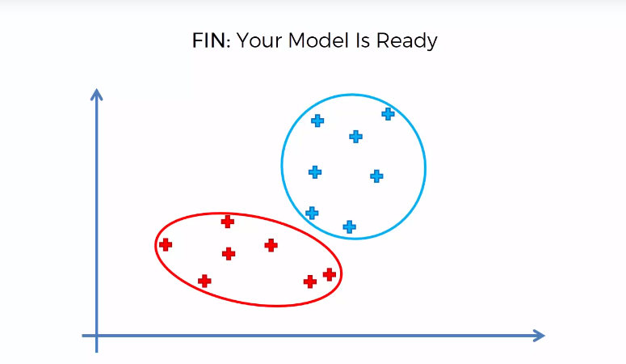
K-Means Clustering
In the End, we got:

Slide 17
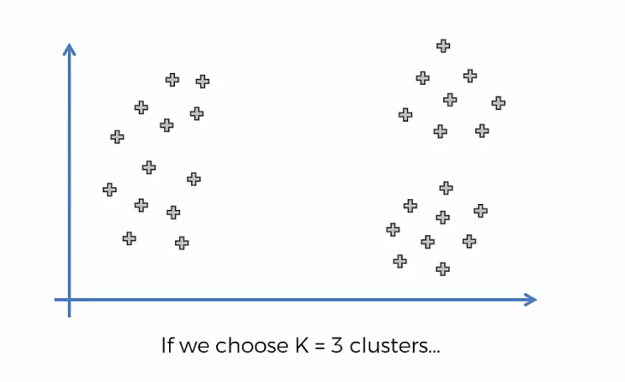
K-Means – Random Initialization Trap
Suppose we choose 3 cluster

Slide 18
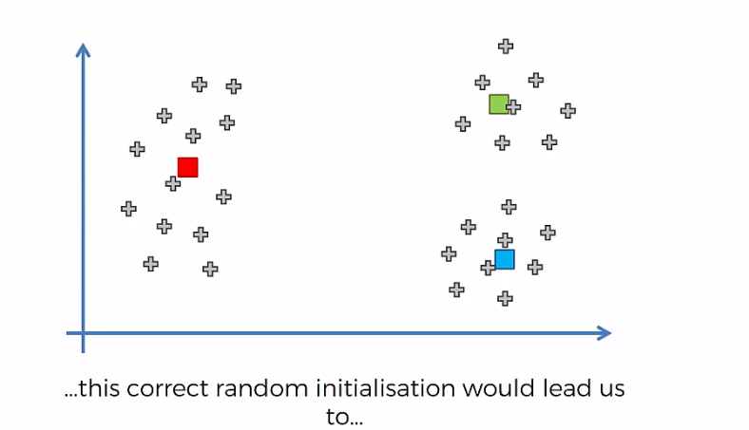
K-Means – Random Initialization Trap
If we follow the step and choose the centroid as below

Slide 19
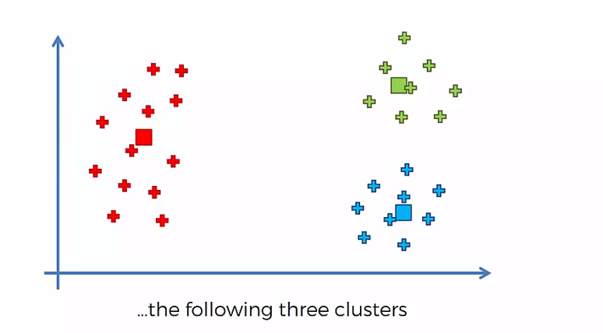
K-Means – Random Initialization Trap

Slide 20
K-Means – Random Initialization Trap
What will happen if we choose centroid at different location ?

Slide 21
K-Means – Random Initialization Trap

Slide 22
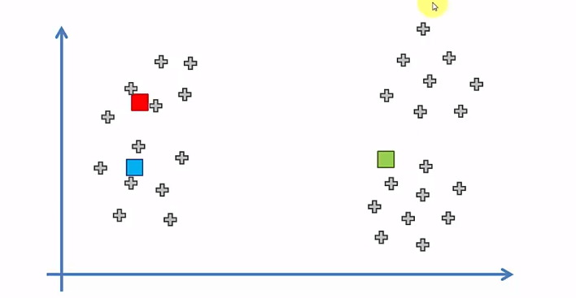
K-Means – Random Initialization Trap
g

Slide 23
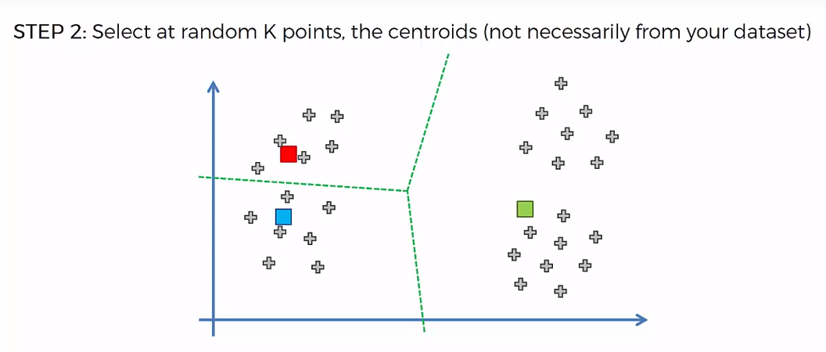
K-Means – Random Initialization Trap

Slide 24
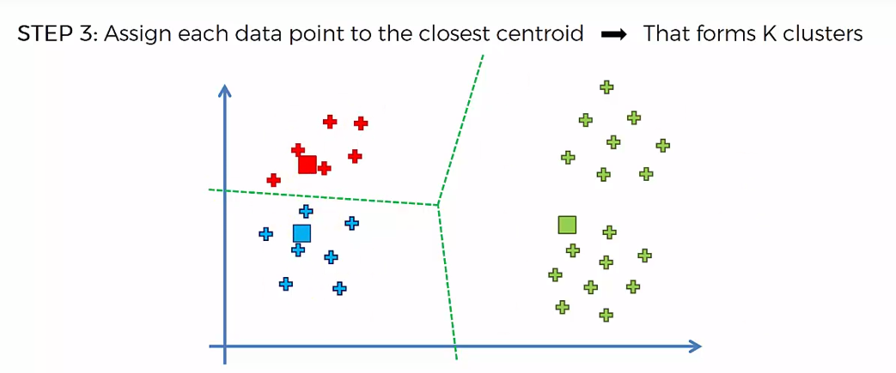
K-Means – Random Initialization Trap

Slide 25
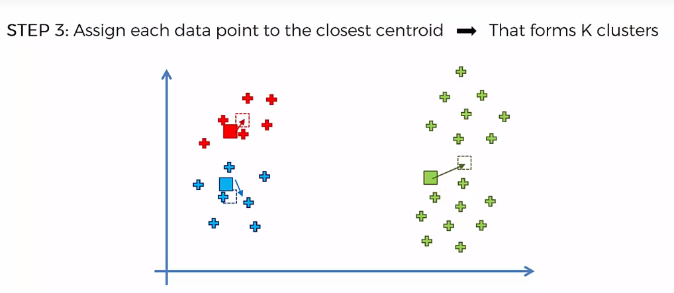
K-Means – Random Initialization Trap

Slide 26
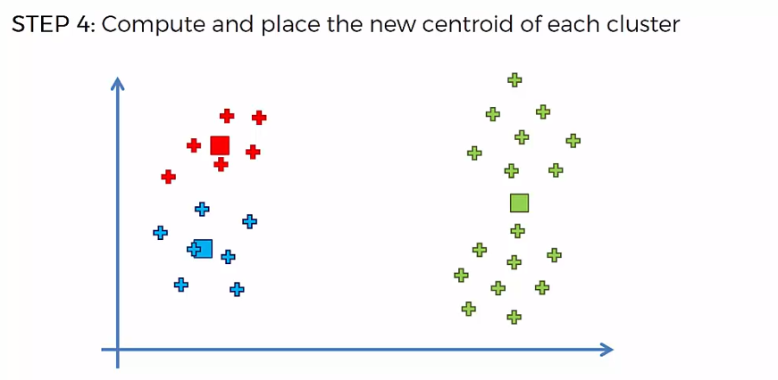
K-Means – Random Initialization Trap

Slide 27
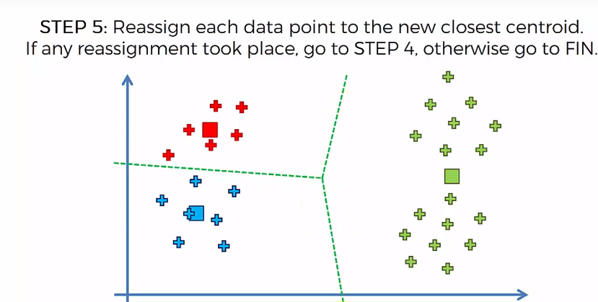
K-Means – Random Initialization Trap
Re-Draw the new line

Slide 28
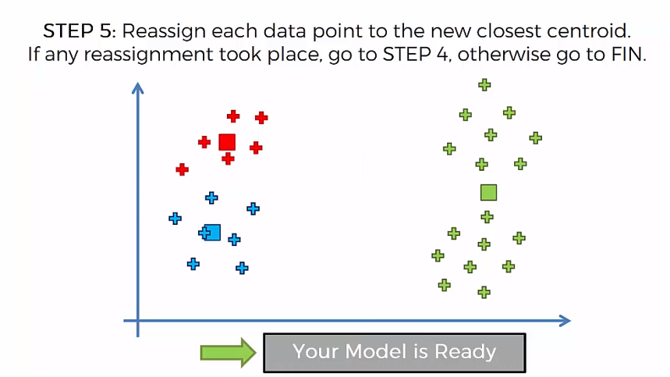
K-Means – Random Initialization Trap

Slide 29
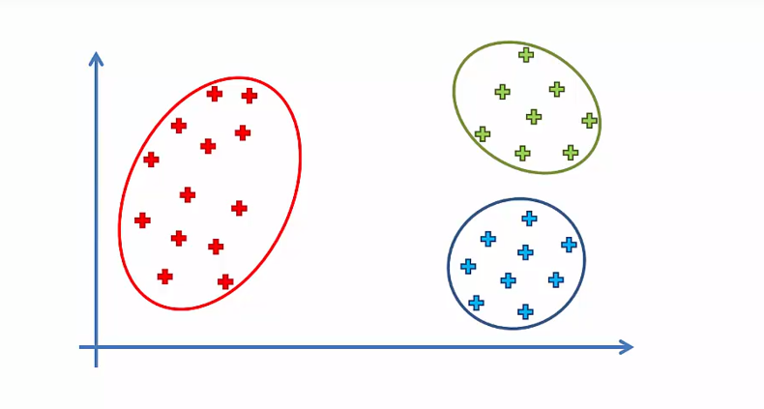
K-Means – Random Initialization Trap
In the start ….. This is what we concluded

Slide 30
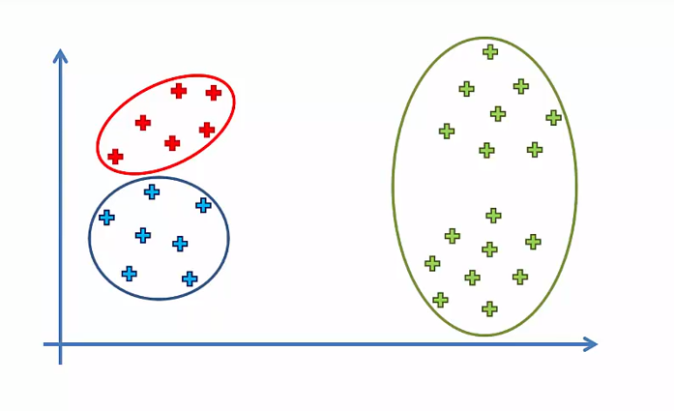
K-Means – Random Initialization Trap
This is what we got due to selecting of the centroid

Slide 31
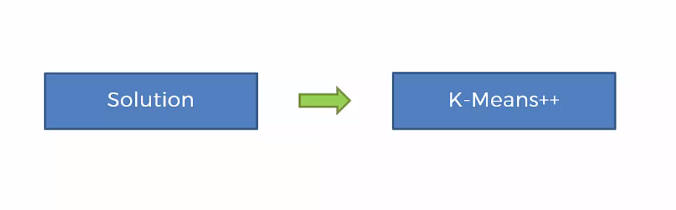
K-Means – Random Initialization Trap
Solution is …

Slide 32
K-Means – Choosing the right # of clusters

Slide 33
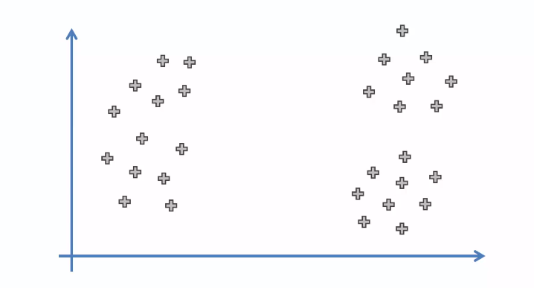
K-Means – Choosing the right # of clusters
Sample Scatter Plot

Slide 34
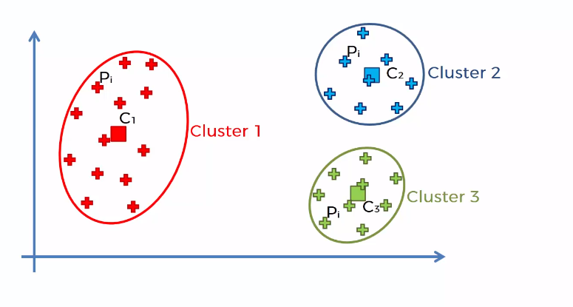
K-Means – Choosing the right # of clusters
We choose 3 cluster

Slide 35
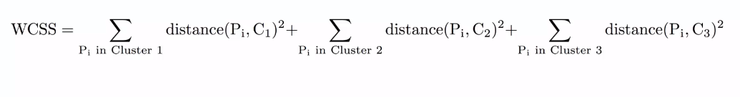
K-Means – Choosing the right # of clusters
The metrics which help us to determine are called –
WCSS: Within-Cluster-Sum-of-Squares

Slide 36
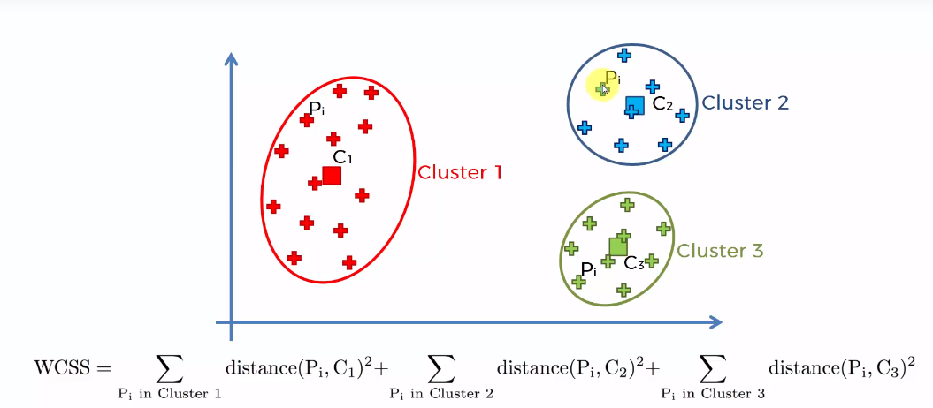
K-Means – Choosing the right # of clusters

Slide 37
K-Means – Choosing the right # of clusters
Lets Rewind

Slide 38
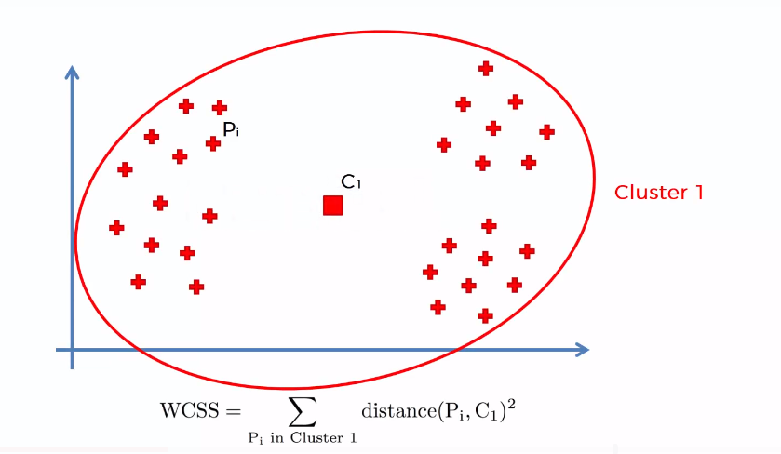
K-Means – Choosing the right # of clusters
Cluster : 1

Slide 39
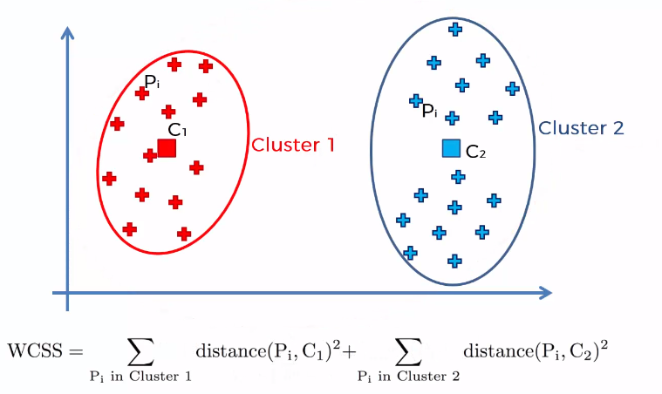
K-Means – Choosing the right # of clusters
Cluster : 2

Slide 40
K-Means – Choosing the right # of clusters
Cluster : 3

Slide 41
K-Means – Choosing the right # of clusters
How many cluster we can created?
Total number of cluster we can create will be equivalent to total number of point we have in our database.
What will be the WSCC in this case?
The Answer is – ‘ 0’

Slide 42
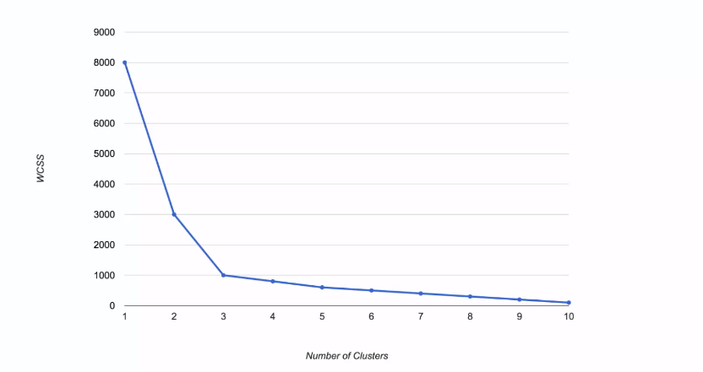
K-Means – Choosing the right # of clusters
If we do a plotting this is how it will look like:

Slide 43

K-Means – Choosing the right # of clusters
This chart is known as elbow method and it helps us to determine the optimal number of cluster.

Slide 44
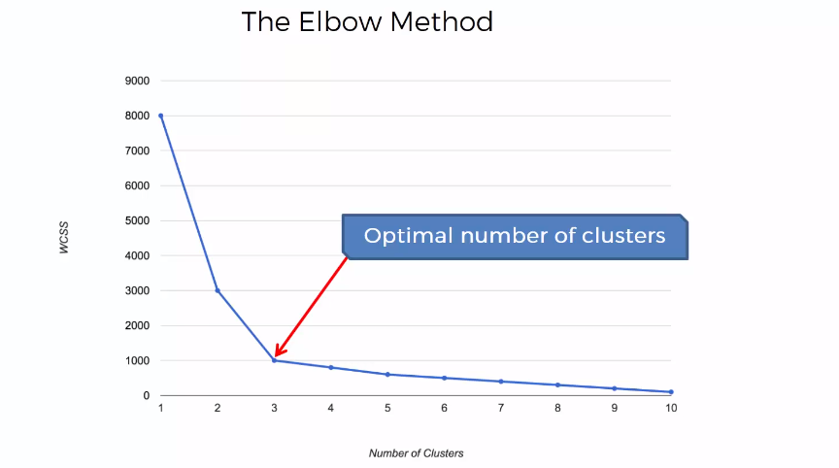
K-Means – Choosing the right # of clusters

Slide 45
Hierarchical Clustering

Slide 46
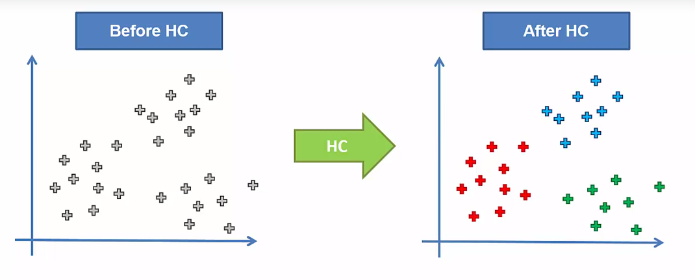
Hierarchical Clustering
This is the result

Slide 47
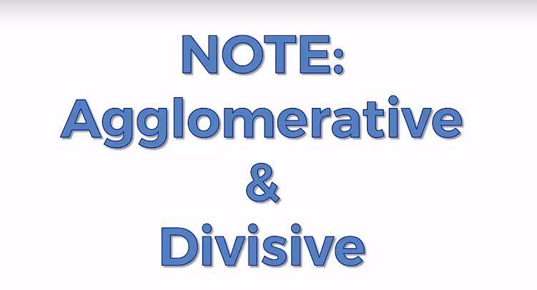
Hierarchical Clustering
There are 2 types of Hierarchical Clustering:

Slide 48
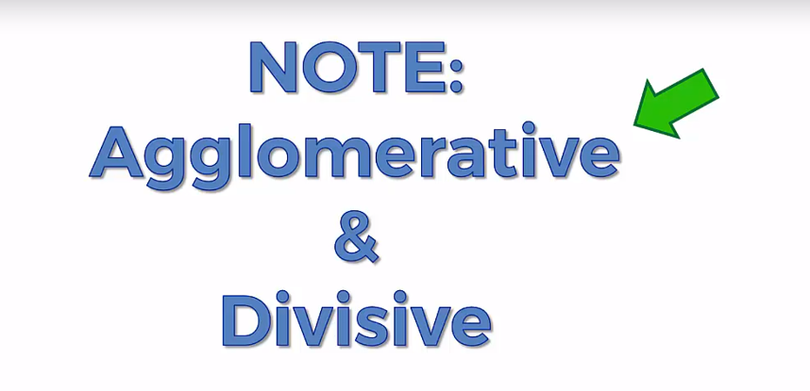
Hierarchical Clustering
We will focus on Agglomerative Approach i.e. bottom up approach.
Divisive Approach is the opposite i.e. Top Down approach.

Slide 49
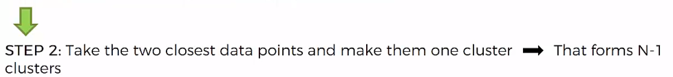
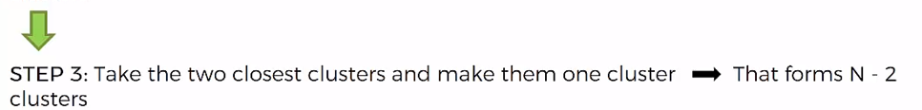

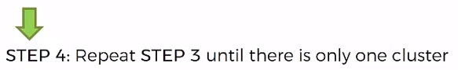
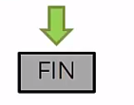
Agglomerative Hierarchical Clustering
Step wise:

Slide 50
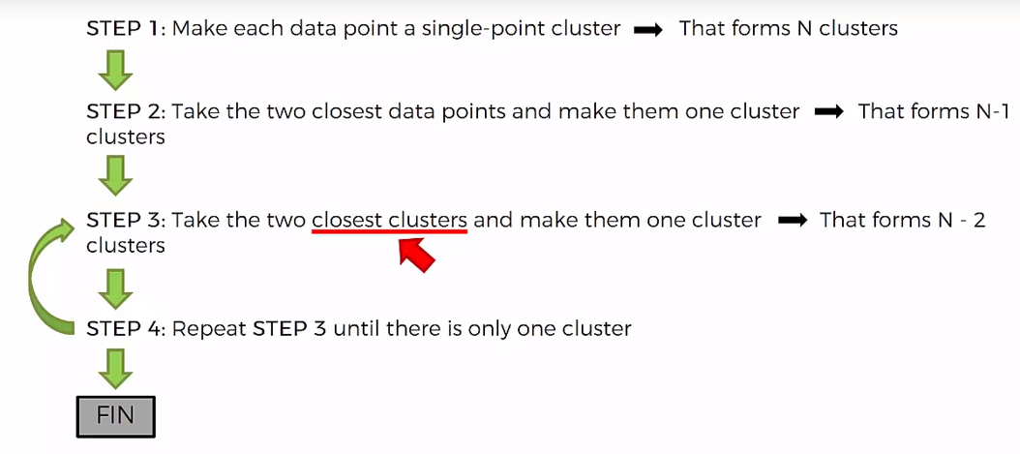
Agglomerative Hierarchical Clustering

Slide 51
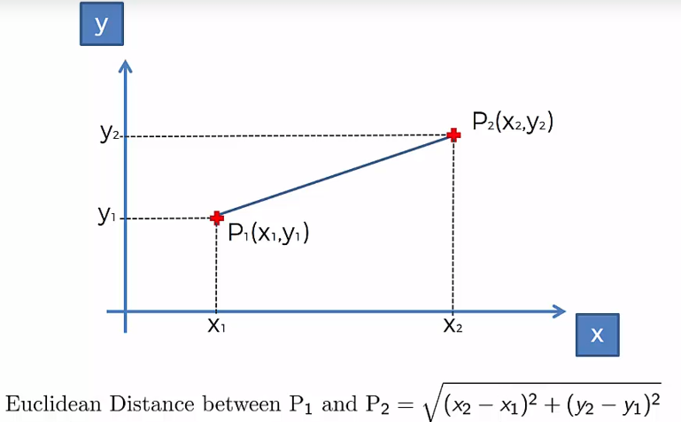
Euclidean Distance
Closeness is measured by using Distance Formulae : example – Euclidean Distance

Slide 52
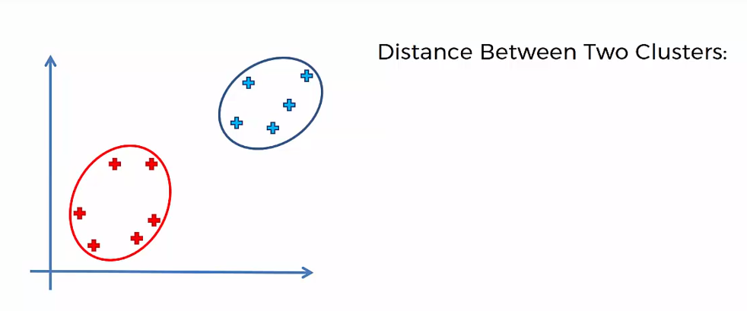
Agglomerative Hierarchical Clustering
How to measure distance between 2 clusters

Slide 53
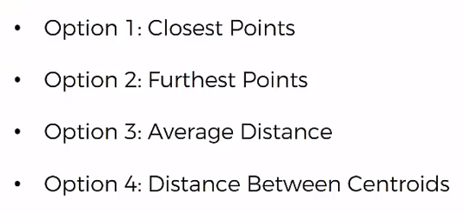
Agglomerative Hierarchical Clustering
Distance can be measured by using following Options

Slide 54
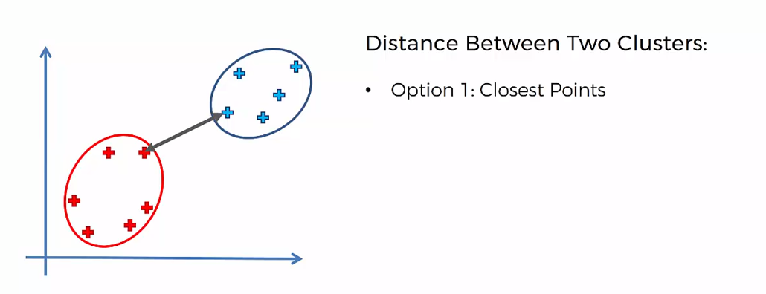
Agglomerative Hierarchical Clustering
Option 1

Slide 55
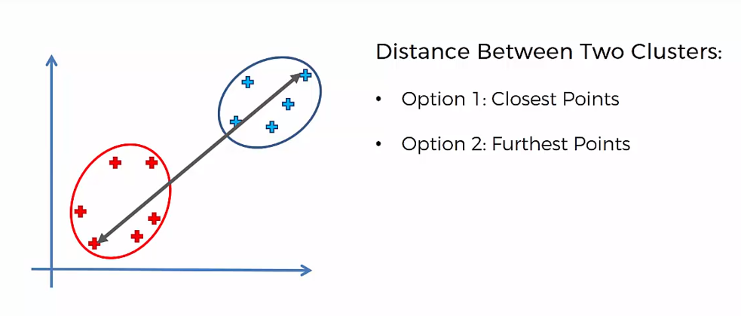
Agglomerative Hierarchical Clustering
Option 2

Slide 56
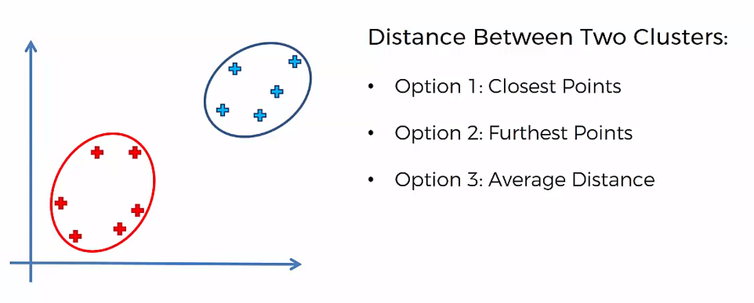
Agglomerative Hierarchical Clustering
Option 3

Slide 57
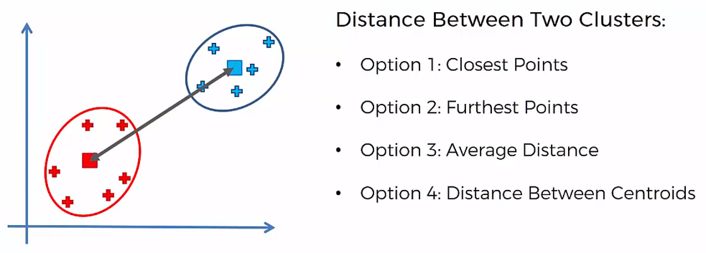
Agglomerative Hierarchical Clustering
Option 4

Slide 58
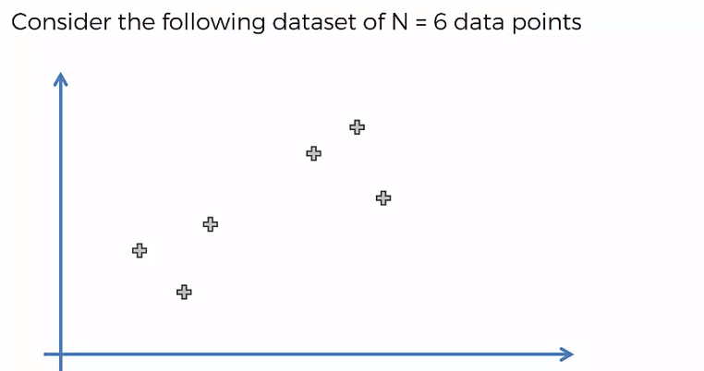
Agglomerative Hierarchical Clustering
Let’s Start step by step approach :

Slide 59

Agglomerative Hierarchical Clustering
STEP 1

Slide 60

Agglomerative Hierarchical Clustering
STEP 2

Slide 61

Agglomerative Hierarchical Clustering
STEP 3

Slide 62

Agglomerative Hierarchical Clustering
STEP 4

Slide 63

Agglomerative Hierarchical Clustering
STEP 4 - Repeat

Slide 64

Agglomerative Hierarchical Clustering
STEP 4 - Repeat

Slide 65
Agglomerative Hierarchical Clustering
How hierarchical clustering works.
Hierarchical Clustering remember this step in Memory and it uses it to create a Dendogram.
How it is created?

Slide 66

Agglomerative Hierarchical Clustering
g

Slide 67

Agglomerative Hierarchical Clustering

Slide 68

Agglomerative Hierarchical Clustering
g

Slide 69

Agglomerative Hierarchical Clustering
g
This distance between 2 point is the actual dis-similarity between the 2 point.

Slide 70

Agglomerative Hierarchical Clustering
g

Slide 71

Agglomerative Hierarchical Clustering
g

Slide 72

Agglomerative Hierarchical Clustering
g

Slide 73

Agglomerative Hierarchical Clustering
g

Slide 74
Agglomerative Hierarchical Clustering
How the optimal clustering is determined ?
Hierarchical Clustering creates a threshold line in Dendrograms, which determines the number of cluster.
Let’s understand that…..

Slide 75

Agglomerative Hierarchical Clustering
Dendrogram with 2 cluster

Slide 76

Agglomerative Hierarchical Clustering
Dendrogram with 4 cluster

Slide 77

Agglomerative Hierarchical Clustering
Dendrogram with 6 cluster

Slide 78
Agglomerative Hierarchical Clustering
What Hierarchical Clustering does is.
It looks at the vertical line which has largest distance.
But, that line does not get cut by the horizontal line.

Slide 79

Agglomerative Hierarchical Clustering
The Largest Distance vertical line, not getting cut by any horizontal line.

Slide 80

Agglomerative Hierarchical Clustering
Optimal # of cluster is 2

Slide 81

Agglomerative Hierarchical Clustering
Test – Guess the cluster

Slide 82

Agglomerative Hierarchical Clustering
Answer is 3

Slide 83

K-Means v/s Hierarchical Clustering
Pros and Cons

